Slide 1

F1nance
TEAM 2:
Venkata Padmavathi Dhanakudharam | Sai Swaroop Manne | Sai Gnandeep Vangapandu | Kavya Sri Myakala | Vinay Suhaas Gandi | Shivani Nallu | Mounika Musuku | Aasmeen Shaik | Vinh Long Tran | Deep Vallabhabhai Chothani

Slide 2



Agenda
Code Snippets
Frontend | Backend
GITHUB
Repo structure | Prerequisites | Installation
DEPLOYMENT
JENKINS

Slide 3
Github URL:
https://github.com/sillysavant/f1nance

Slide 4

Repo Structure
F1nance-Final-Presentation
Contains all the approved deliverables and final documents
F1nance
Frontend - client repo
F1nance-Backend
Backend - server repo

Slide 5
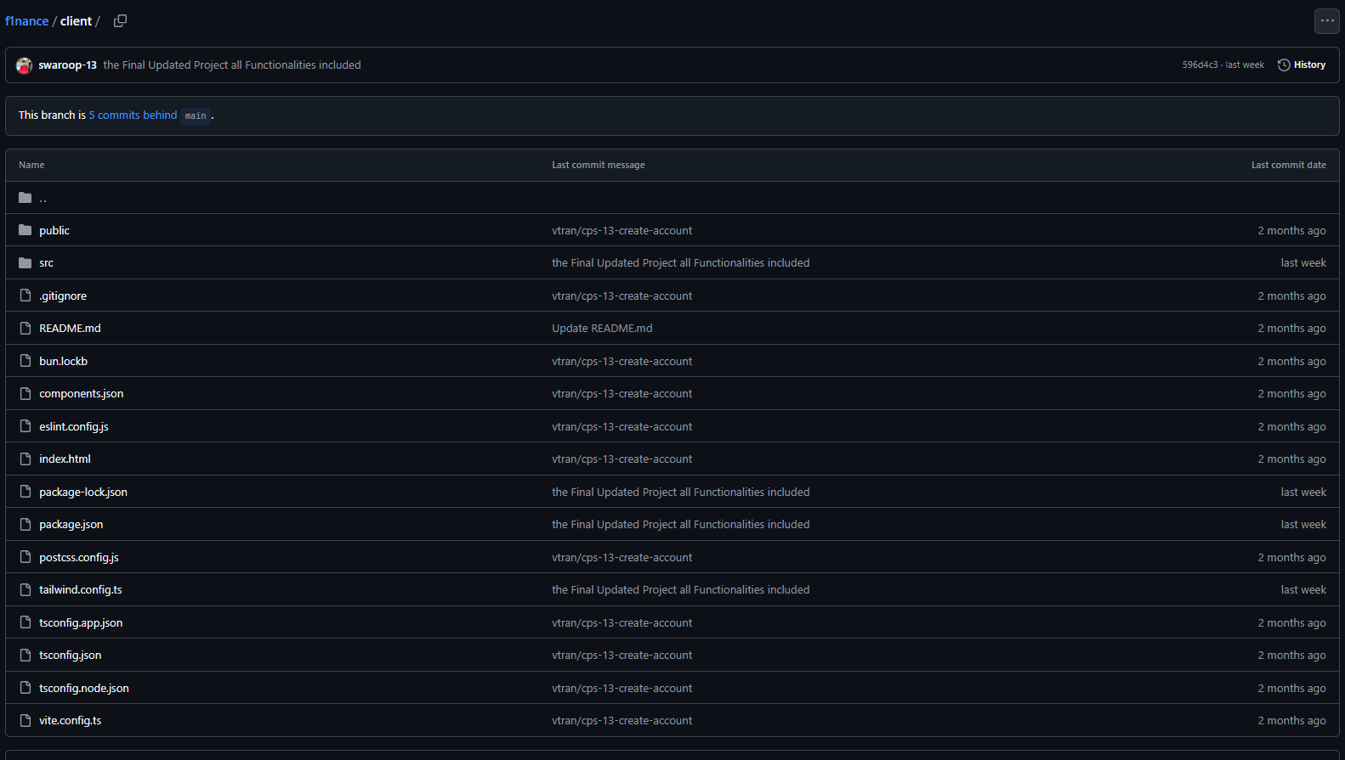
Repo Structure (Client - Frontend)

Slide 6
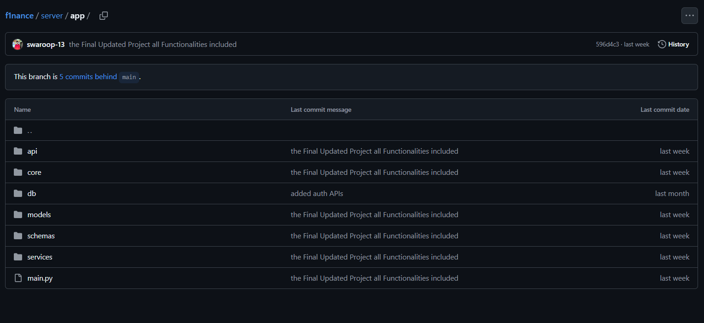
Repo Structure (Server - Backend)

Slide 7
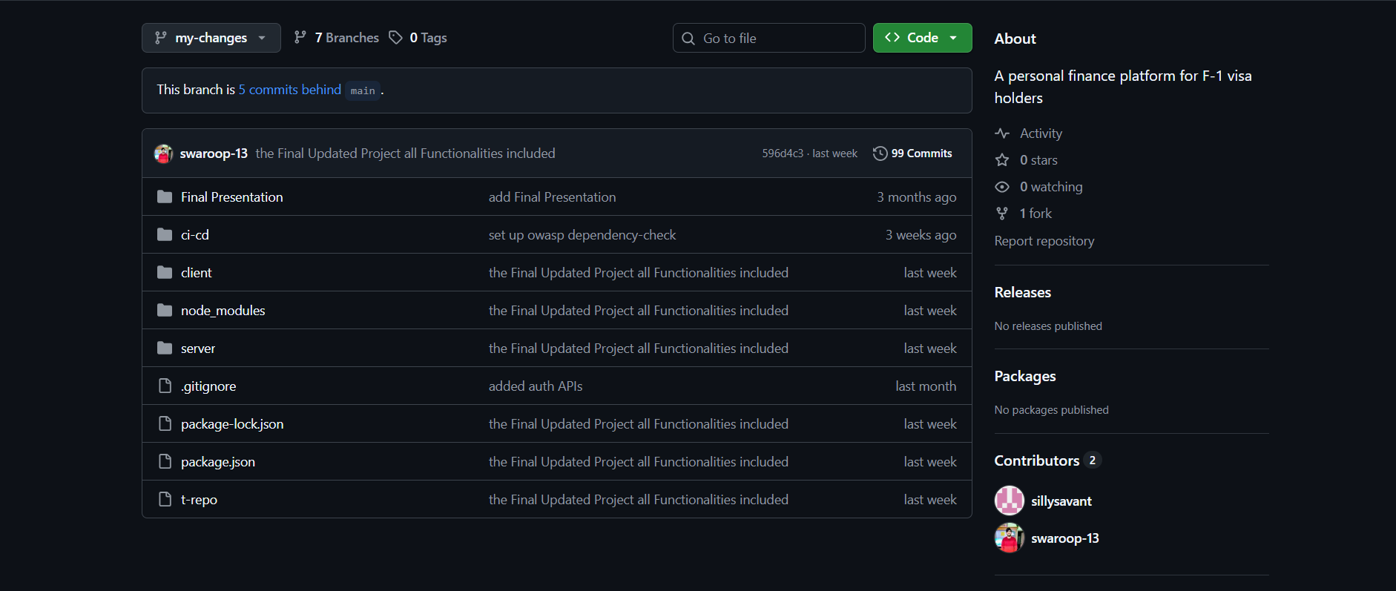
Repo Structure (Final Deliverables)

Slide 8




Installation guide
Backend folder
run the command [python -m venv venv]
and then [uvicorn app.main:app --reload]
Application Home
at localhost:3000, you will land on the homepage of F1NANCE.
Navigate through the application
and its features.
Clone the Repo
git clone <url>
Frontend folder
run the command [ npm install ]
and then [ npm start ]

Slide 9
Installation guide
Install Jenkins
curl -fsSL https://pkg.jenkins.io/debian-stable/jenkins.io-2023.key \
| sudo tee /usr/share/keyrings/jenkins-keyring.asc > /dev/null
echo deb [signed-by=/usr/share/keyrings/jenkins-keyring.asc] \
https://pkg.jenkins.io/debian-stable binary/ \
| sudo tee /etc/apt/sources.list.d/jenkins.list > /dev/null
sudo apt update
sudo apt install jenkins
Run Jenkins
sudo systemctl enable jenkins
sudo systemctl start jenkins

Slide 10

Code Snippets

Slide 11
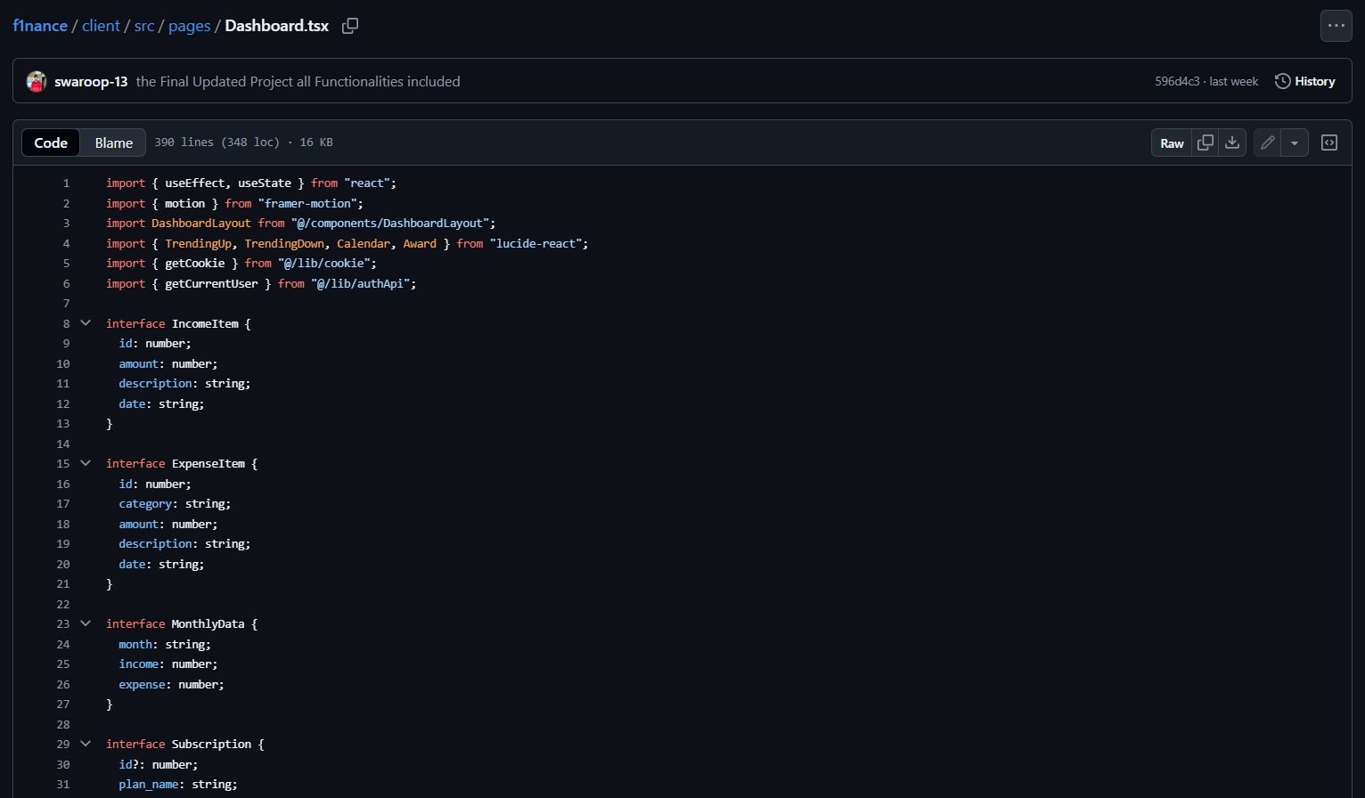
Dashboard (Frontend)

Slide 12
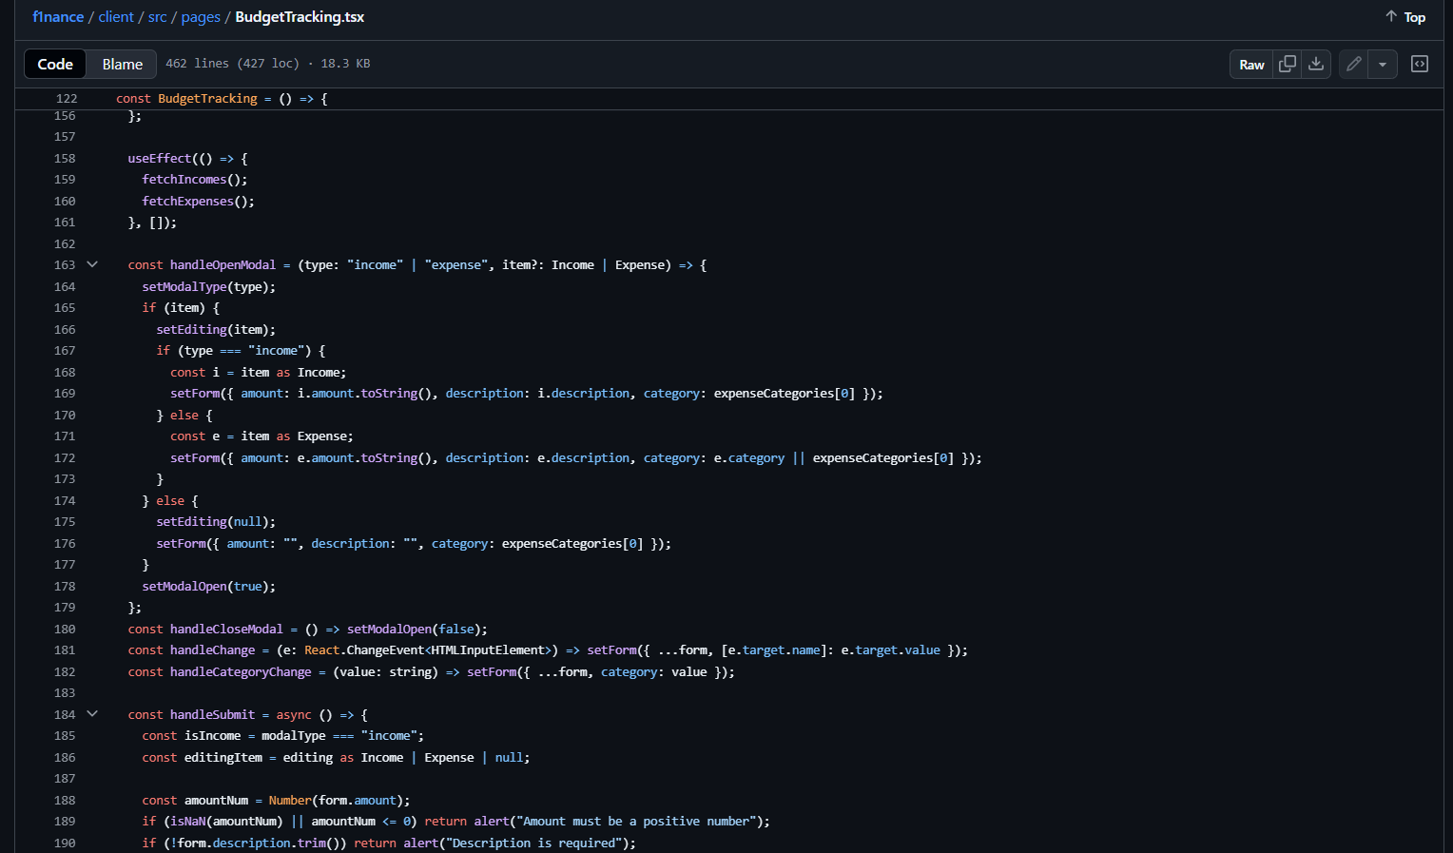
BudgetTracking - Frontend

Slide 13
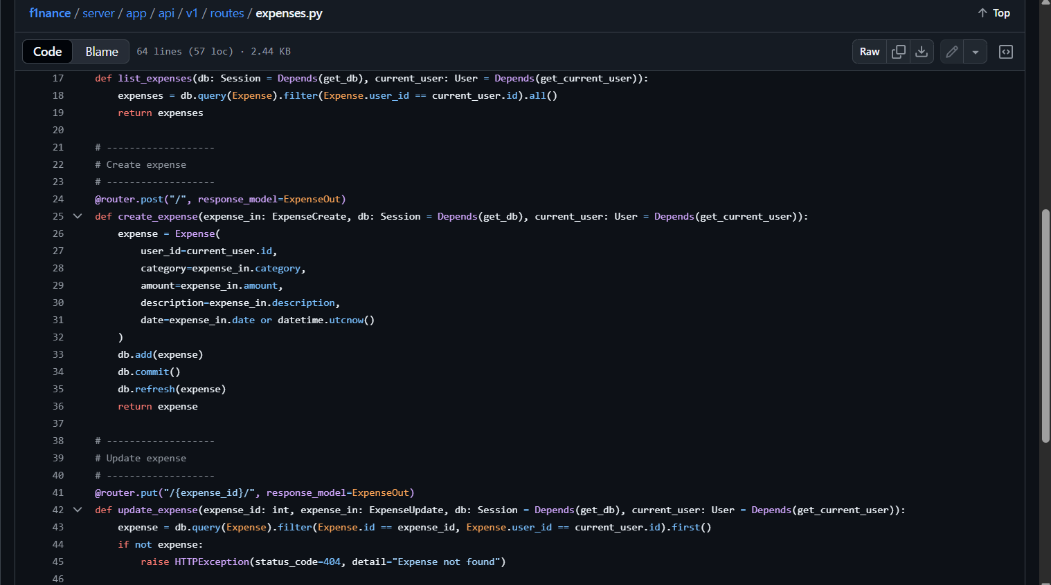
BudgetTracking - Backend

Slide 14
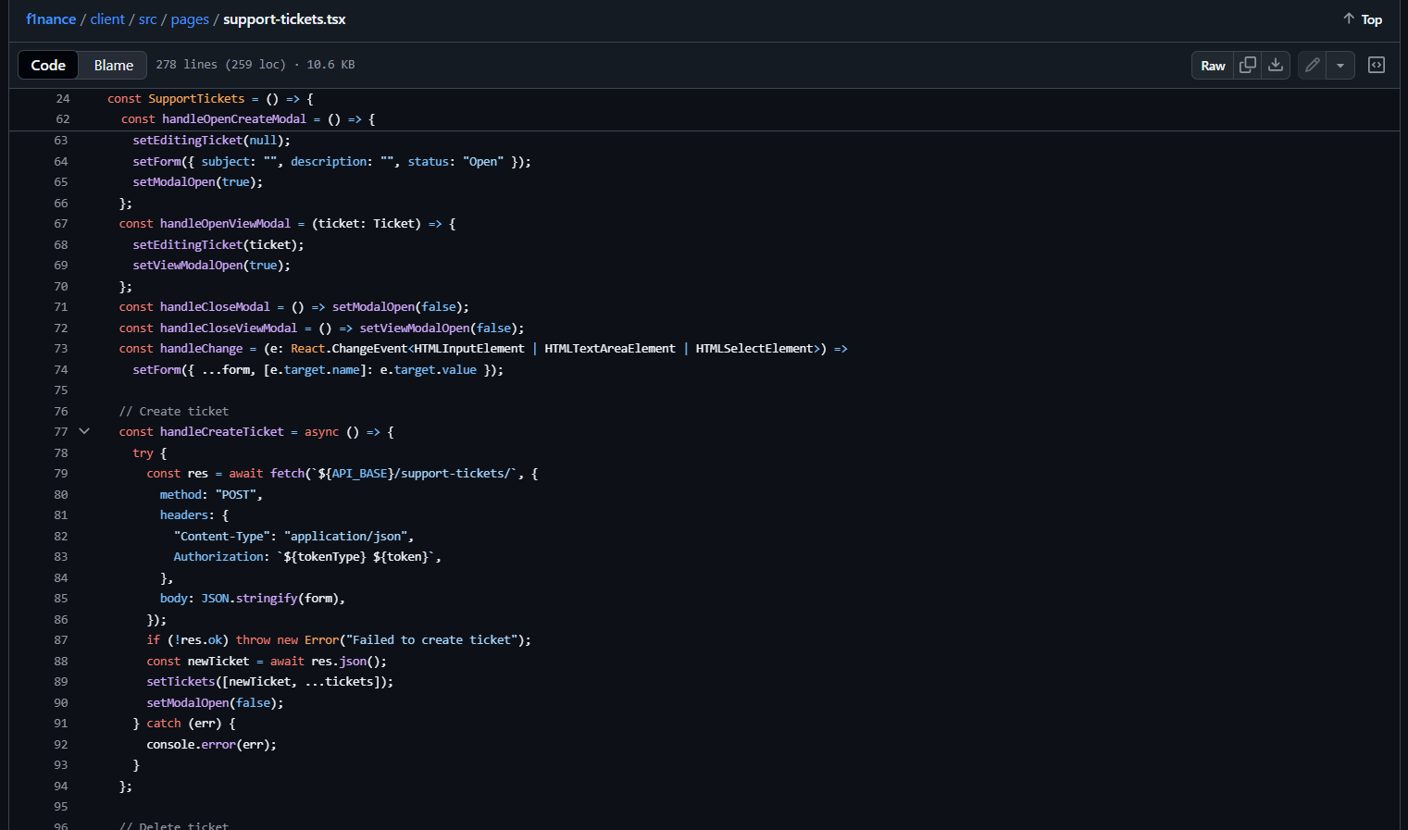
Support-tickets (Frontend)

Slide 15
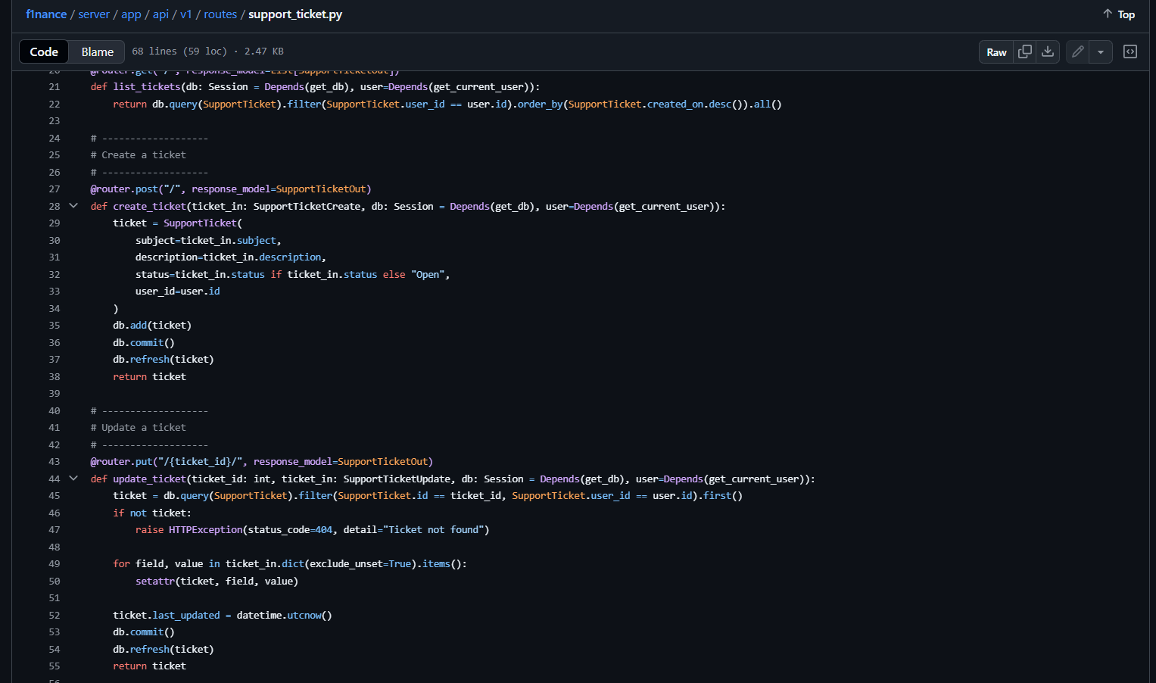
Support-tickets (Backend)

Slide 16
Deployment

Slide 17
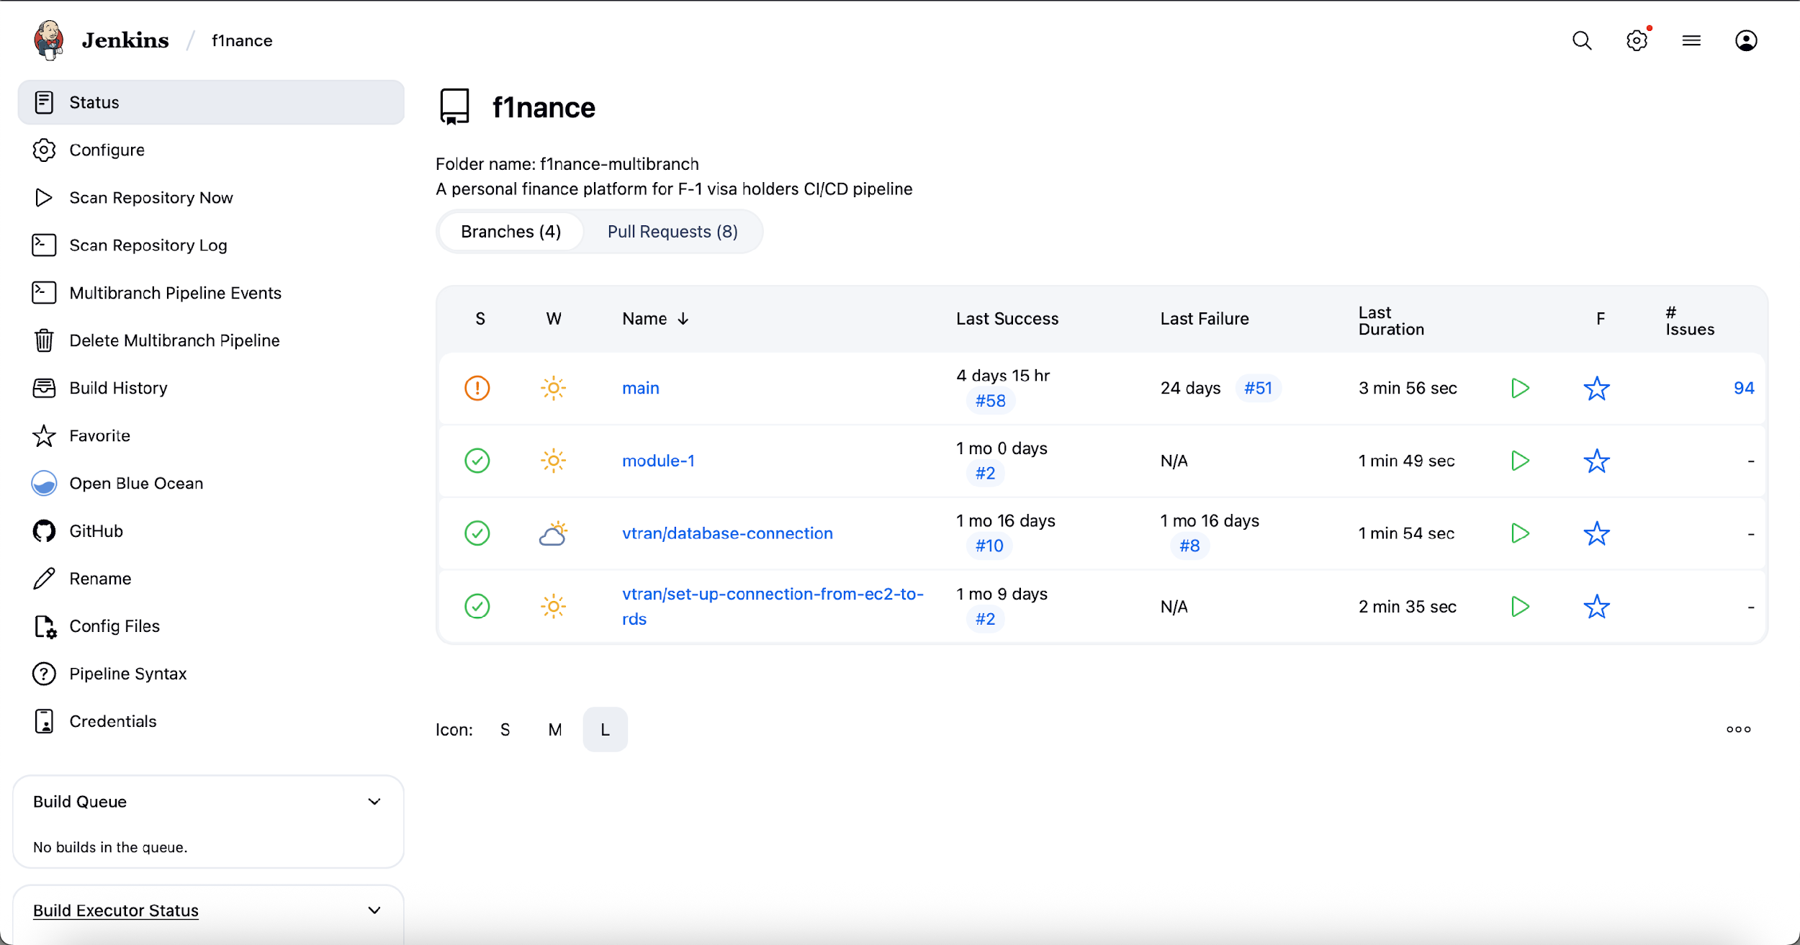
Jenkins Dashboard

Slide 18
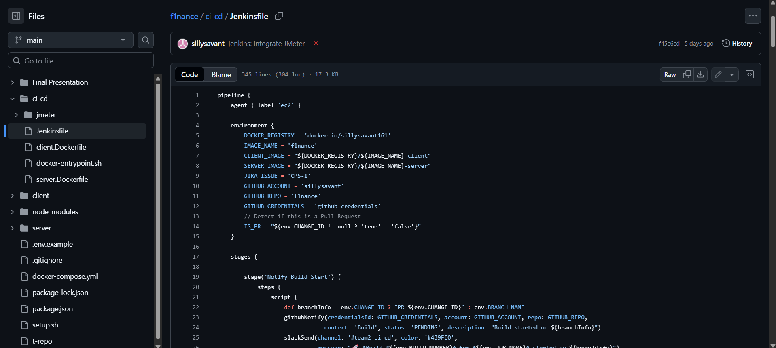
Pipeline

Slide 19
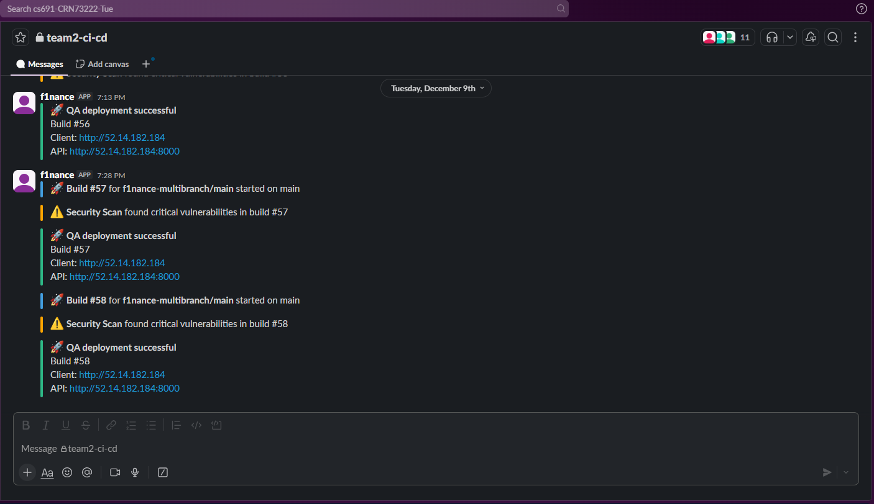
Slack Notification

Slide 20
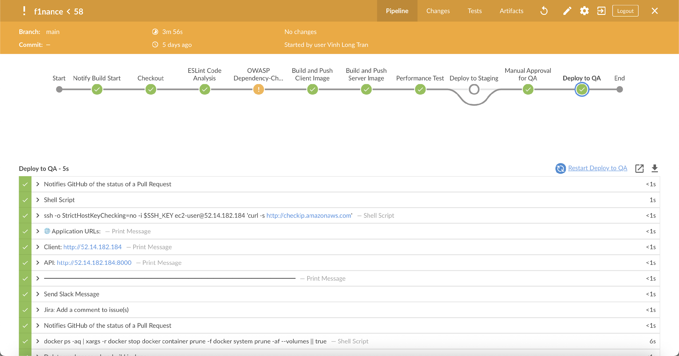
Blue Ocean Plugin

Slide 21

THANK YOU !

